Slide 1
Binary Search
TIP102
Week 7
Notes:
🌟 Purpose: Set a positive tone, encourage participation, and ensure everyone is ready for the session.
✅ What should I be doing?
Greet students as they join.
🎙️ What should I be saying?
Welcome, everyone! I’m excited to see you all today.
🙌🏽 How should I engage students?
Call on a few students by name to say hello or share how they’re doing.

Slide 2
1 | Welcome 👋🏽 | 0:00 - 0:10
2 | Divide-and-Conquer | 0:10 - 0:45
3 | BREAK | 0:45 - 0:50
4 | Collaborative Problem Solving | 0:50 - 1:50
5 | Wrap Up | 1:50 - 2:00
Notes:
🌟 Purpose: Provide an overview of today’s session and set expectations for timing and content.
✅ What should I be doing?
Walk through the agenda, explaining each section briefly.
Highlight any key areas where students should pay extra attention, such as the demo or collaborative problem-solving time.
🎙️ What should I be saying?
Here’s our agenda for today’s session. We’ll start with a warm welcome and move into our main topic, Divide-and-Conquer.
After a short break, we’ll dive into collaborative problem-solving to apply what we’ve learned.
Finally, we’ll wrap up by reviewing key takeaways and next steps.
Let me know if you have any questions about the flow of the session.
🙌🏽 How should I engage students?
Ask students if they’re excited or curious about any particular section.
Encourage them to share their goals for the session in the chat.
Acknowledge any questions or concerns about the session structure and address them briefly.

Slide 3
Welcome! 👋🏽
10 minutes

Slide 4


Turn on your cameras
Fill out the entry ticket
Notes:
🌟 Purpose: Encourage visual engagement to foster connection during the session.
✅ What should I be doing?
Prompt students to enable their cameras and submit the entry ticket.
🎙️ What should I be saying?
Let’s kick off our session by turning on our cameras!
Also, don’t forget to fill out the entry ticket to help us organize breakout rooms later.
🙌🏽 How should I engage students?
Use humor or compliments: "Let’s see those smiles!"
Acknowledge and thank students who turn on their cameras.

Slide 5
5 minutes

Slide 6
Recursion is kind of fun
Peers helping each other in breakout
Problem set questions were phrased poorly
Notes:
🌟 Purpose: Share feedback from the previous session and highlight areas of success and improvement.
✅ What should I be doing?
Summarize feedback from the previous session's survey and present key takeaways.
🎙️ What should I be saying?
From your feedback, it seems many of you enjoyed [highlighted aspect]. One suggestion was [area for improvement]. We’ll work on that today.
🙌🏽 How should I engage students?
Ask: "Does anyone have additional feedback or suggestions?"

Slide 7

Announcements & Reminders
UPDATE ME!
Add any announcements or reminders. These will often come from the SSL or Liz, so be sure to check in with them to see if there are any that need to be added here if that information hasn’t been shared with you already.
DELETE THIS BOX WHEN YOU’RE DONE!

Slide 8
Recursion…When?!
Divide & Conquer Break problems into smaller subproblems and combine results. 📌 Examples: Merge Sort, Binary Search, Fibonacci, Tree depth
Traversal Visit every node/item in a structured way (often in trees/graphs). 📌 Examples: Tree DFS (pre/in/postorder), Linked List printing
Backtracking Try all possibilities, undoing choices when needed. 📌 Examples: N-Queens, Subsets, Sudoku Solver
Combinatorial Generation Recursively build all valid combinations/permutations. 📌 Examples: Valid Parentheses, Letter Combinations, Combination Sum
Repetitive Actions Use recursion just to repeat something or apply side effects. 📌 Examples: Print 1 to N, Reverse string with prints
✨ Tip: Ask yourself — Am I solving + combining? Traversing? Trying options?

Slide 9
Divide-and-Conquer
35 minutes

Slide 10
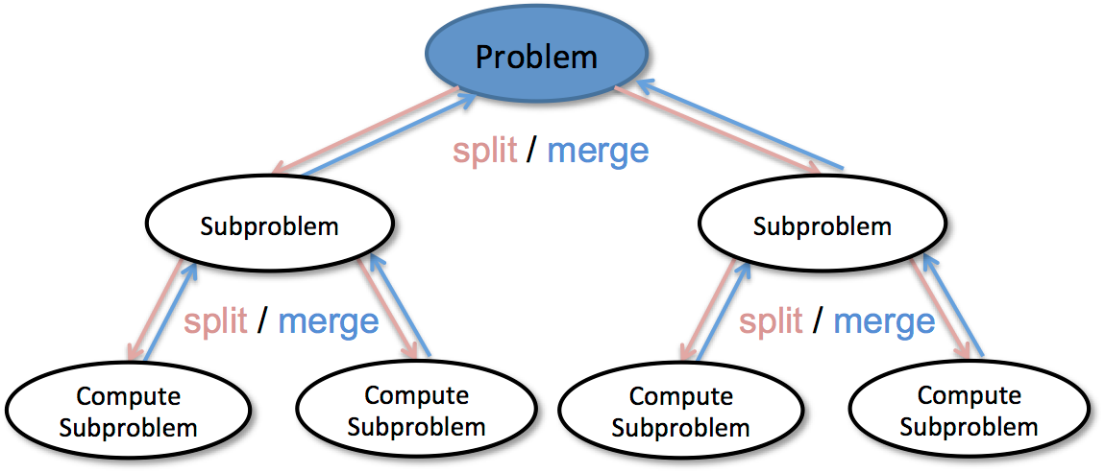
What is Divide-and-Conquer?
Divide: Break the problem into smaller, identical subproblems.
Conquer: Solve the subproblems (often using recursion).
Combine: Merge the solutions to form the final result.
Notes:
🌟 Purpose: Introduce the concept of divide-and-conquer in problem-solving.
✅ What should I be doing?
Present the three key steps: Divide, Conquer, and Combine.
Highlight its role in algorithms and emphasize its versatility.
🎙️ What should I be saying?
Divide-and-conquer is a powerful problem-solving strategy. The idea is to break a problem into smaller, identical subproblems, solve each one, and then combine the solutions. Can anyone think of situations where this might be useful?
🙌🏽 How should I engage students?
Pause to let students brainstorm and share ideas in the chat or aloud.
Respond to their suggestions and connect them back to the strategy.

Slide 11
2 minutes
In the chat . . .
What real-world tasks might involve divide-and-conquer strategies?
Notes:
Technically speaking:
Merge Sort / Quick Sort
Binary Search
Parallel Computing / MapReduce
Real world applications:
GPS route planning
Chess playing algorithm
🌟 Purpose: Help students connect divide-and-conquer to real-world tasks.
✅ What should I be doing?
Facilitate a discussion to generate ideas about real-world applications of divide-and-conquer strategies.
🎙️ What should I be saying?
In the chat, share a real-world task that you think could involve divide-and-conquer. For example, sorting through a stack of papers or planning a large event might use this strategy. What do you think?
🙌🏽 How should I engage students?
Acknowledge and expand on student responses to keep the discussion flowing.
Provide an example if the discussion stalls.

Slide 12
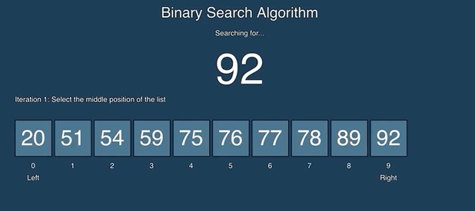
Binary Search: A Divide & Conquer Example
Efficiently searches for a target value in a sorted list.
Notes:
🌟 Purpose: Introduce binary search as a specific application of divide-and-conquer.
✅ What should I be doing?
Explain how binary search works in a sorted list by halving the search space.
Emphasize its efficiency compared to linear search.
🎙️ What should I be saying?
Binary search is a classic example of divide-and-conquer. Instead of checking each item one by one, it divides the list into two parts and eliminates half the list at each step. Why do you think this is faster than linear search for sorted lists?
🙌🏽 How should I engage students?
Encourage students to share their reasoning in the chat or on mic.
Validate correct answers and clarify any misconceptions.

Slide 13
2 minutes
In the chat . . .
Why do you think binary search is faster than linear search for sorted lists?

Slide 14
20 minutes
Write a function that performs binary search to find the index of a target value in a sorted list. If the value does not exist, return -1.
Example:
Input: nums = [1, 3, 5, 7, 9, 11, 12], target = 5 Output: 2
Notes:
🌟 Purpose: Demonstrate how to implement the binary search algorithm step-by-step, highlighting the Divide-and-Conquer approach and showing its application to solve a problem efficiently.
✅ What should I be doing?
Walk students through the UMPIRE strategy, focusing on Understand, Plan, and Implement (UPI).
Write code live, narrating your thought process and breaking the problem into smaller steps.
Pause regularly to check for understanding, answer questions, and invite students to predict or suggest the next steps.
If you encounter a mistake, normalize it by discussing the debugging process.
🎙️ What should I be saying?
Understand (U):
"The goal is to find the index of a target value in a sorted list using binary search. If the target value doesn’t exist, we return -1. What does binary search mean? It’s a Divide-and-Conquer technique where we repeatedly split the search space in half."
"Here’s the example: given nums = [1, 3, 5, 7, 9, 11] and target = 5, the output should be 2 because 5 is at index 2. Does this make sense so far?"
Plan (P):
"Let’s break this down. First, we initialize two pointers: low at the start of the list and high at the end. We calculate the middle index and compare the middle value with the target."
"If the middle value matches the target, we return the index. If the target is smaller, we search the left half by updating high. If it’s larger, we search the right half by updating low."
"Finally, if we exhaust the search space, we return -1 to indicate the target isn’t present. Any questions about the approach?"
Implement (I):
Live-code the solution: def binary_search(nums, target):
low, high = 0, len(nums) - 1
while low <= high:
mid = (low + high) // 2
if nums[mid] == target:
return mid
elif nums[mid] < target:
low = mid + 1
else:
high = mid - 1
return -1
Narrate as you code:
"We initialize low and high..."
"Now we calculate the middle index..."
"Let’s check the conditions: if nums[mid] equals the target, we return mid. If it’s less than the target, we update low, and if it’s greater, we update high."
🙌🏽 How should I engage students?
Ask students to predict the next step before writing it. For example:
"What happens if the target is smaller than the middle value? Which pointer should we update?"
After writing the function, ask:
"What do you think will happen if the target is 6, which isn’t in the list? What will our function return?"
Run multiple test cases and involve students in suggesting inputs:
"Let’s try nums = [1, 3, 5, 7, 9, 11] and target = 7. What index do you expect as the output?"
Normalize mistakes by intentionally making an error (e.g., forgetting to update low or high) and debugging it live:
"Oops, I forgot to update low. See how it’s causing an infinite loop? Let’s fix that. This is why debugging is such an important skill!"

Slide 15
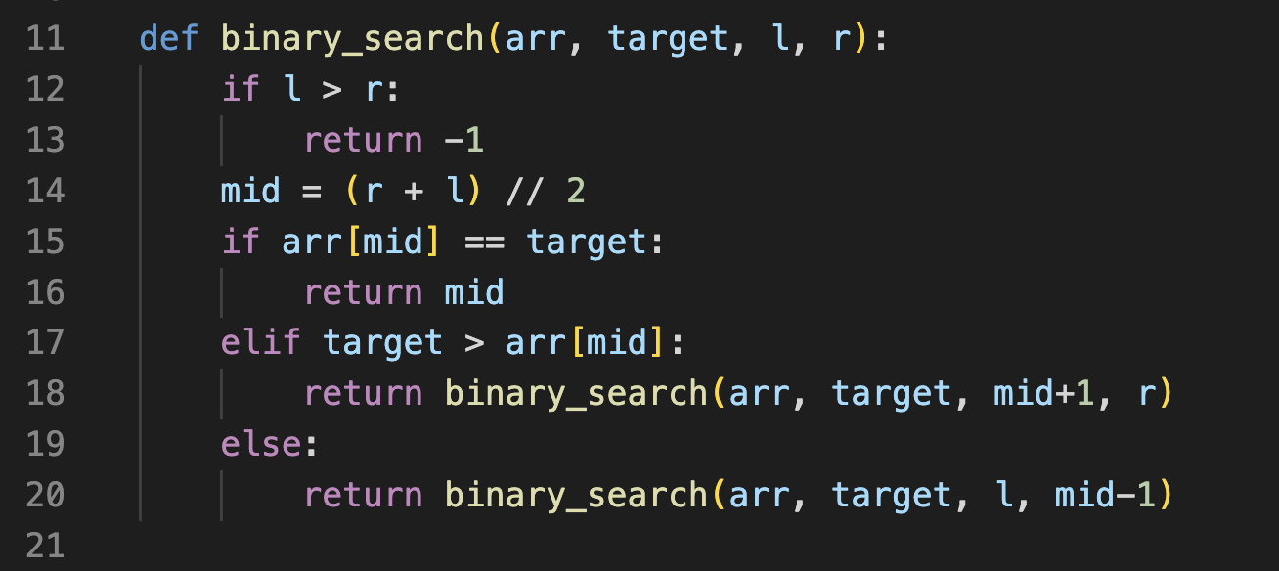
Review
nums = [1, 3, 5, 7, 9, 11, 12], target = 5
L(0) R(6)

Slide 16
Review
nums = [1, 3, 5, 7, 9, 11, 12], target = 5
L(0) R(6)

Slide 17
Review
nums = [1, 3, 5, 7, 9, 11, 12], target = 5
L(0) mid R(6)
(0+6) // 2 = 3

Slide 18
Review
nums = [1, 3, 5, 7, 9, 11, 12], target = 5
L(0) mid R(6)
arr[3] = 7

Slide 19
Review
nums = [1, 3, 5, 7, 9, 11, 12], target = 5
L(0) mid R(6)
5 > 7 ?

Slide 20
Review
nums = [1, 3, 5, 7, 9, 11, 12], target = 5
L(0) mid R(6)

Slide 21

Review
nums = [1, 3, 5, 7, 9, 11, 12], target = 5
L(0) mid R(6)

Slide 22
Review
nums = [1, 3, 5, 7, 9, 11, 12], target = 5
L(0) R(2)

Slide 23
Review
nums = [1, 3, 5, 7, 9, 11, 12], target = 5
L(0) R(2)

Slide 24
Review
nums = [1, 3, 5, 7, 9, 11, 12], target = 5
L(0)midR(2)
(0+2) // 2 = 1

Slide 25
Review
nums = [1, 3, 5, 7, 9, 11, 12], target = 5
L(0)midR(2)
arr[1] = 3

Slide 26
Review
nums = [1, 3, 5, 7, 9, 11, 12], target = 5
L(0)midR(2)
5 > 3 ?

Slide 27
Review
nums = [1, 3, 5, 7, 9, 11, 12], target = 5
L(0)midR(2)
5 > 3 ?

Slide 28
Review
nums = [1, 3, 5, 7, 9, 11, 12], target = 5
L(2)
R(2)
5 > 3 ?

Slide 29
Review
nums = [1, 3, 5, 7, 9, 11, 12], target = 5
L(2)
R(2)
5 > 3 ?

Slide 30
Review
nums = [1, 3, 5, 7, 9, 11, 12], target = 5
L(2)
R(2)
(2+2) // 2 = 2
5 > 3 ?

Slide 31
Review
nums = [1, 3, 5, 7, 9, 11, 12], target = 5
L(2)
R(2)
5 > 3 ?
arr[2] = 5

Slide 32
Review
nums = [1, 3, 5, 7, 9, 11, 12], target = 5
L(2)
R(2)
return 2
5 > 3 ?

Slide 33
Review
nums = [1, 3, 5, 7, 9, 11, 12], target = 5
L(2)
R(2)
5 > 3 ?

Slide 34
Review
nums = [1, 3, 5, 7, 9, 11, 12], target = 5
L(2)
R(2)
return 2
5 > 3 ?

Slide 35
Review
nums = [1, 3, 5, 7, 9, 11, 12], target = 5
L(2)
R(2)
return 2

Slide 36
Common Complexities (Fastest to Slowest)
Function | Big(O) | Examples
Constant | O(1) | odd or even number
Logarithmic | O(log(n)) | finding element on sorted array with binary search
Linear | O(n) | find max element in unsorted array
Log-linear | O(n log(n)) | sorting elements in array with merge sort
Quadratic | O(n²) | sorting array with bubble sort
How fast an algorithm is or how much memory it uses as the input size grows
Notes:
🌟 Purpose: Connect theoretical complexities to specific coding examples.
✅ What should I be doing?
Use relatable examples to clarify how different complexities manifest in code.
🎙 What should I be saying?
Let’s look at examples: Checking if a number is even is O(1), finding an element in a sorted array with binary search is O(log n), and summing all elements in an unsorted array is O(n).
Each example helps us understand how the complexity relates to the problem size and the operations performed.
Notice that for larger input sizes, higher complexities like O(n²) grow significantly faster, which can make algorithms inefficient.
🙌🏽 How should I engage students?
Ask: "Which of these examples do you encounter most often in your coding practice? How do you handle performance concerns?"

Slide 37
Runtime Complexity
arr = [1, 3, 5, 7, 9, 11]
arr_V2 = [1, 1, 3, 3, 5, 5, 7, 7, 9, 9, 11, 11]
O(1) constant
Get the element at index 0
O(log(n)) logarithmic
Search for a number (binary search)
O(n) linear
Print out all elements of arr

Slide 38
Logarithmic Runtime Complexity
arr = [1, 3, 5, 7, 9, 11]
Each time, binary search cuts the array in half:
After 1 step: 6 → 3 elements
After 2 steps: 3 → 1 or 2 elements
After 3 steps: 1 element
This process of halving continues until there’s 1 element left to check. The number of times you can halve n until you're down to 1 is roughly log₂(n).
So for this array:
n = 6
log₂(6) ≈ 2.58, round up → worst-case 3 steps

Slide 39
Runtime Complexity
"How many times can I divide n by 2 until I get to 1?"
That’s log₂(n)
VERSUS
"If I can take k steps (or do k halvings), how big of an input can I handle?"
"What value of n gives me k steps?" The answer: n = 2^k ← that’s an exponent

Slide 40
Runtime Complexity
arr = [1, 3, 5, 7, 9, 11]
arr_V2 = [1, 1, 3, 3, 5, 5, 7, 7, 9, 9, 11, 11]
POLL: how many steps will it take to find an element (that exists) in arr_V2 with binary search?
3
12
2
4

Slide 41
Runtime Complexity
arr = [1, 3, 5, 7, 9, 11]
arr_V2 = [0, 1, 3, 3, 5, 5, 7, 7, 9, 9, 11, 11]
Step 1 ⇒ 6 element
Step 2 ⇒ 3 elements
Step 3 ⇒ 1 or 2 elements
Step 4 ⇒ 1 elements
“As things get bigger, I don’t check all of them — I keep cutting the problem in half, which makes it super fast.”
👉 Doubling input only adds 1 extra step to your algorithm. Time complexity increases incredibly slowly as the input size increases

Slide 42
Binary Search Related Interview Questions
Search in a rotated sorted array
First/last occurrence of a number
Find square root of a number
Find peak element
Find smallest/largest element under constraints
Koko eating bananas

Slide 43

Break Time!
Take 5 mins to step away from the computer. Feel free to turn off your camera and return promptly after 5 mins.
Notes:
🌟 Purpose: Provide a short break to refresh and re-energize.
✅ What should I be doing?
Announce the break and remind students to return on time.
Play the countdown timer video (be sure to share sound).
🎙️ What should I be saying?
Let’s take 5 minutes to step away from the screen. Be sure to return promptly.

Slide 44
Collaborative Problem Solving
60 minutes

Slide 45
60 minutes
🏃🏽 Navigate to your breakout room.
👋🏽 Introduce yourselves!
🧑🏽‍💻 Work on the problems for your selected unit.

Slide 46
Wrap Up
10 minutes

Slide 47
Notes:
🌟 Purpose: End the session on a positive note.
✅ What should I be doing?
Prompt students to share their reflections in the chat.
🎙️ What should I be saying?
Let’s celebrate your wins. Share one good thing you learned or accomplished today!
🙌🏽 How should I engage students?
Read a few responses aloud and celebrate with enthusiasm.

Slide 48
Summary
⚔️ Divide and Conquer Strategy
Break the problem into smaller parts
Solve each part recursively
Combine the results (if needed)
Efficient for problems like searching, sorting, and optimization
🧠 Key Takeaways
Recursion simplifies problems with repeated structure
Divide and Conquer helps design efficient algorithms
Binary Search is a classic example with both patterns

Slide 49


Session Survey Time!
Notes:
🌟 Purpose: Gather feedback to improve future sessions.
✅ What should I be doing?
Share the survey link and emphasize its importance.
🎙️ What should I be saying?
Your feedback helps us make these sessions even better. Please take a moment to complete the survey.
🙌🏽 How should I engage students?
Thank students for their input and explain how feedback has been used in the past.

Slide 50

Final Reminders
Finish the problem sets for additional practice
Take the weekly HackerRank assessment by Sunday @ midnight
Notes:
🌟 Purpose: Provide a short break to refresh and re-energize.
✅ What should I be doing?
Announce the break and remind students to return on time.
Play the countdown timer video (be sure to share sound).
🎙️ What should I be saying?
Let’s take 5 minutes to step away from the screen. Be sure to return promptly.

